Slide 1
Dobbs’ Go – Team Meeting
May 23, 2024
Dobbs Elementary

Slide 2
Spring MAP Data
Dobbs Elementary

Slide 3
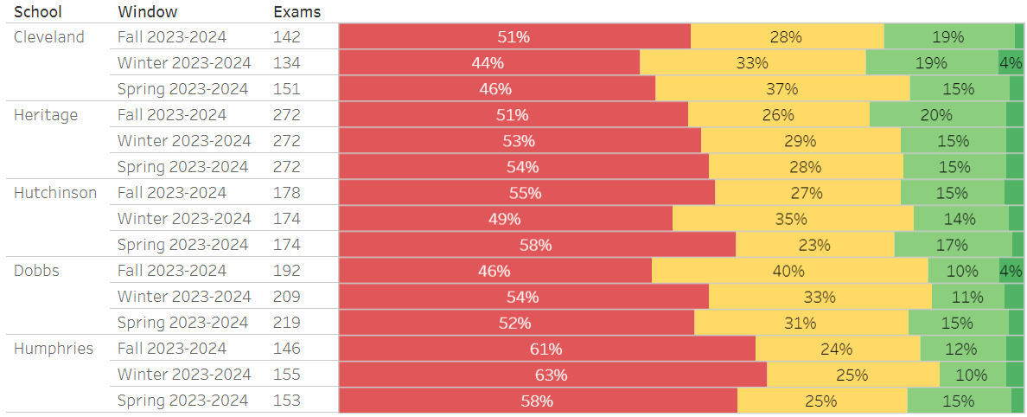
S. Atlanta Cluster – Fall ~ Winter ~ Spring Reading

Slide 4
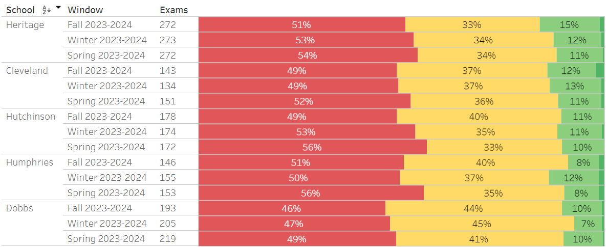
S. Atlanta Cluster – Fall ~ Winter ~ Spring MATH

Slide 5
2nd Grade
RDG
MATH
Notes:
Notes to presenter:
What was important about this learning experience?
How is it relevant to your course, yourself, or your society or community?
Why is this significant?
This SmartArt allows you add images and text to help outline your process. If a picture is worth a thousand words, then pictures and words should help you communicate this reflection on learning perfectly! You can always click on Insert>SmartArt to change this graphic or select the graphic and click on the Design contextual menu to change the colors.

Slide 6
3rd Grade
RDG
MATH
Notes:
Notes to presenter:
What was important about this learning experience?
How is it relevant to your course, yourself, or your society or community?
Why is this significant?
This SmartArt allows you add images and text to help outline your process. If a picture is worth a thousand words, then pictures and words should help you communicate this reflection on learning perfectly! You can always click on Insert>SmartArt to change this graphic or select the graphic and click on the Design contextual menu to change the colors.

Slide 7
4th Grade
RDG
MATH
Notes:
Notes to presenter:
What was important about this learning experience?
How is it relevant to your course, yourself, or your society or community?
Why is this significant?
This SmartArt allows you add images and text to help outline your process. If a picture is worth a thousand words, then pictures and words should help you communicate this reflection on learning perfectly! You can always click on Insert>SmartArt to change this graphic or select the graphic and click on the Design contextual menu to change the colors.

Slide 8
5th Grade
RDG
MATH
Notes:
Notes to presenter:
What was important about this learning experience?
How is it relevant to your course, yourself, or your society or community?
Why is this significant?
This SmartArt allows you add images and text to help outline your process. If a picture is worth a thousand words, then pictures and words should help you communicate this reflection on learning perfectly! You can always click on Insert>SmartArt to change this graphic or select the graphic and click on the Design contextual menu to change the colors.

Slide 9
5th Grade
SCIENCE
Notes:
Notes to presenter:
What was important about this learning experience?
How is it relevant to your course, yourself, or your society or community?
Why is this significant?
This SmartArt allows you add images and text to help outline your process. If a picture is worth a thousand words, then pictures and words should help you communicate this reflection on learning perfectly! You can always click on Insert>SmartArt to change this graphic or select the graphic and click on the Design contextual menu to change the colors.

Slide 10
BASC -3 Results – Semester 1
Notes:
Notes to presenter:
What steps will you be taking as a result of this learning experience?
Did you learn from any failed experiences? How will you do things differently?
What advice will you give to others so they can learn from your experiences?
How can you share what you learned with a real-world audience?
Some examples of next steps might be:
After delivering my first persuasive presentation, I am thinking about joining the debate team.
After making my first film, I’m considering entering it in our school film festival or local film festival.
After connecting with this career expert, I’d like to do some research on that career field because it sounds interesting to me.
This SmartArt allows you add images and text to help outline your process. If a picture is worth a thousand words, then pictures and words should help you communicate this reflection on learning perfectly! You can always click on Insert>SmartArt to change this graphic or select the graphic and click on the Design contextual menu to change the colors.
Feel free to use more than one slide to share your next steps. It also helps to add some video content to explain your message.

Slide 11
Dobbs Writing Data
 | October 2023 | January 2024 | March 2024 Extended Response
3rd Grade | .66 | 1.89 | 1.25
4th Grade | .38 | .93 | 1.33
5th Grade | 1.22 | 1.93 | 1.25

Slide 12
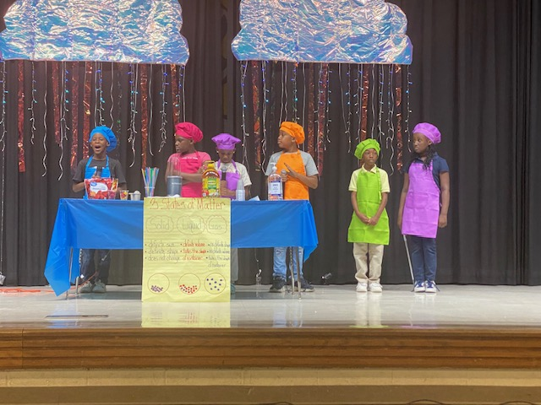
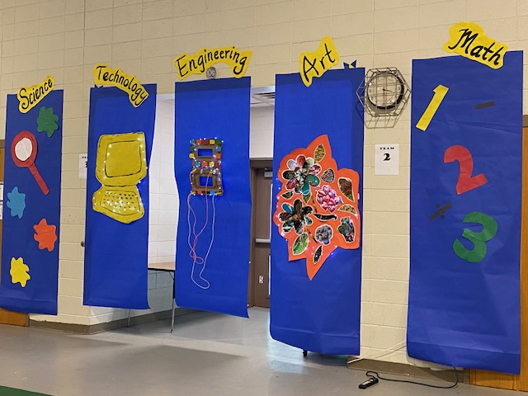
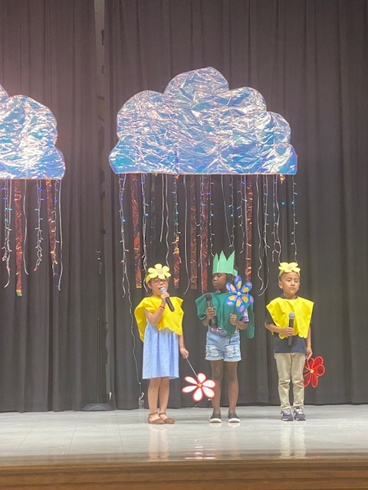
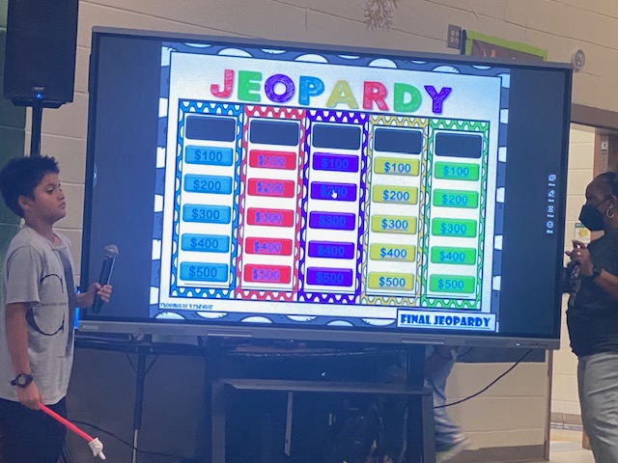
STEAM PBL SHOWCASE Family Engagement

Slide 13
Go –Team Election Results
Parents – Shan Hines & Jessenia Antunez
Staff – Tina Quinn & Briana Spence
Notes:
Notes to presenter:
What steps will you be taking as a result of this learning experience?
Did you learn from any failed experiences? How will you do things differently?
What advice will you give to others so they can learn from your experiences?
How can you share what you learned with a real-world audience?
Some examples of next steps might be:
After delivering my first persuasive presentation, I am thinking about joining the debate team.
After making my first film, I’m considering entering it in our school film festival or local film festival.
After connecting with this career expert, I’d like to do some research on that career field because it sounds interesting to me.
This SmartArt allows you add images and text to help outline your process. If a picture is worth a thousand words, then pictures and words should help you communicate this reflection on learning perfectly! You can always click on Insert>SmartArt to change this graphic or select the graphic and click on the Design contextual menu to change the colors.
Feel free to use more than one slide to share your next steps. It also helps to add some video content to explain your message.

Slide 14
Announcements
Student Recognitions – APS Board Meeting
E-Sports
Minecraft
Math Competition
Science Fair
Last Day of School – Friday, May 24, 2023
Notes:
Notes to presenter:
What steps will you be taking as a result of this learning experience?
Did you learn from any failed experiences? How will you do things differently?
What advice will you give to others so they can learn from your experiences?
How can you share what you learned with a real-world audience?
Some examples of next steps might be:
After delivering my first persuasive presentation, I am thinking about joining the debate team.
After making my first film, I’m considering entering it in our school film festival or local film festival.
After connecting with this career expert, I’d like to do some research on that career field because it sounds interesting to me.
This SmartArt allows you add images and text to help outline your process. If a picture is worth a thousand words, then pictures and words should help you communicate this reflection on learning perfectly! You can always click on Insert>SmartArt to change this graphic or select the graphic and click on the Design contextual menu to change the colors.
Feel free to use more than one slide to share your next steps. It also helps to add some video content to explain your message.

